Slide 1
Denoising Medical Images Using Convolutional Autoencoders
Harshad Ingole - 180050037
Sunil Kumar Meena - 180050107

Slide 2
Denoising Medical Images
X-Rays, MRIs, CTs, ultrasound etc are susceptible to noise. Reasons include different image acquisition techniques to attempt at decreasing the exposure to radiation. As the amount of radiation decreases, the noise level increases.
Denoising is very necessary for proper analysis, both by humans and machines. Denoising is a classical problem given as:
z=x+y; where z is the noisy image, x is the original image and y is the noise assumed to be generated by a well defined process. The goal is to predict x using z.

Slide 3
Denoising using Deep Learning
Many deep learning models have shown promising results in denoising. We have decided to use a Convolutional Autoencoder for the task of Denoising.
Autoencoders are artificial NN that learn efficient data coding by ignoring the noise.
Convolutional layers have the ability to exploit strong spatial correlations in images..
An autoencoder with convolutional layers - a Convolutional Autoencoder - thus easily outperforms traditional denoising methods like median and mean filtering.

Slide 4
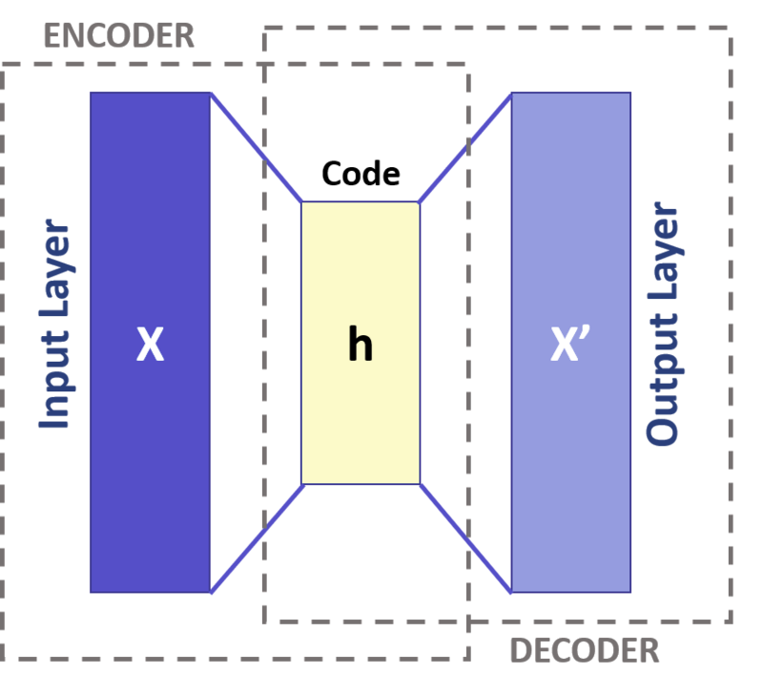
Autoencoders
Widely used for dimensionality reduction and feature learning, autoencoders first encodes the input thereby learning a low dimensional representation. Much like PCA. Then it decodes or upsamples the coded data to give the output.
Basically, it tries to learn an approximation of the identity function but in the process eliminates the “noise”.

Slide 5
Convolutional Autoencoders
Convolutional Autoencoders are based on standard autoencoder architecture but have convolutional encoding and decoding layers. They utilize the full capability of CNN to exploit image structure.
The ith feature map is given as : hi=s(x∗Wi+bi) where ∗ is the convolution operation and s is an activation.

Slide 6
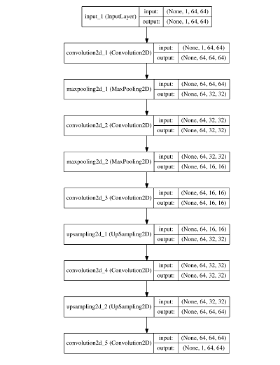
Architecture
The architecture is fairly simple. It consists of 2 encoding convolutional layer. Each consisting of 2D conv followed by maxpooling.
It is followed by two decoding layers. Each consists of upsampling followed by conv.
We were planning on having a deeper architecture with skip symmetric connections.

Slide 7
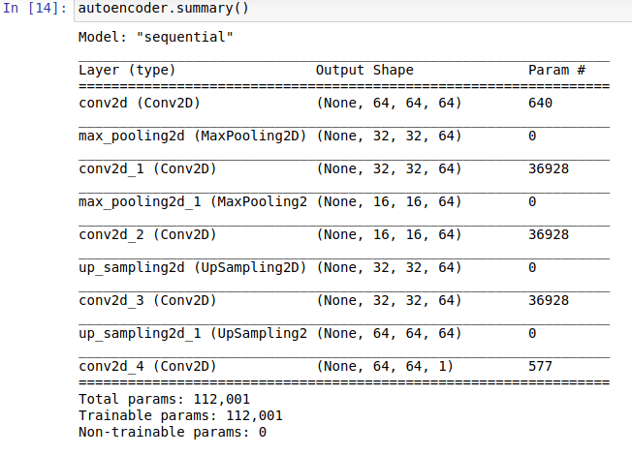
Architecture

Slide 8
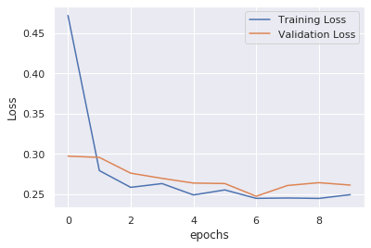
Evaluation
Used 2 datasets - mini-MIAS dataset of
mammograms, and dental radiography database.
Added Gaussian noise to the datasets and trained on 60% of the dataset.
Used binary cross entropy loss function. Ran for 10 epochs with a batch size of 10.

Slide 9
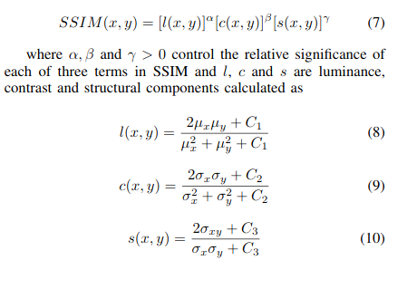
Evaluation
Images were compared using Structural Similarity Index (SSIM) . For original and coded signal x and y :

Slide 10
Results - μ =0, σ= 1, p= 0.1
We could replicate the results in the paper:
Image type | Mammograms | Dental
Noisy | 0.44 | 0.64
CNN DAE | 0.82 | 0.87
Median Filter | 0.73 | 0.85

Slide 11
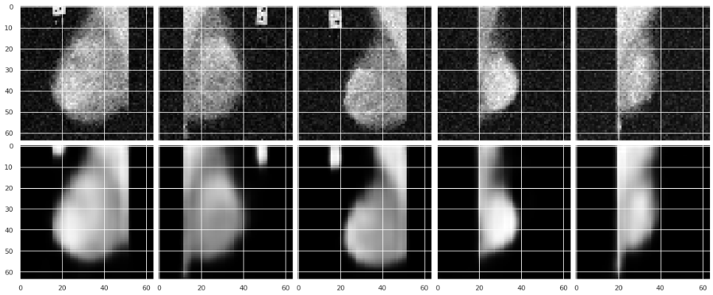
Results - Mammograms

Slide 12
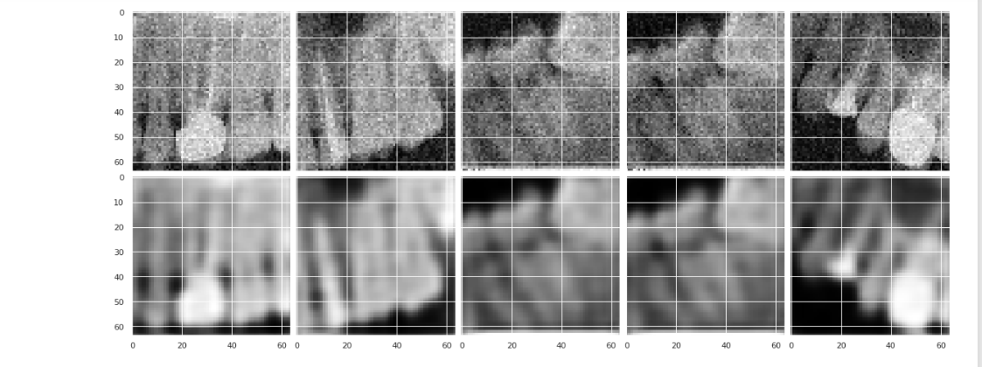
Results - Dental

Slide 13
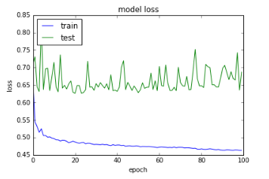
Results
For low noise levels, our model performs better that the traditional method of median filtering
But this is only for low noise levels. The model has a tough time converging at higher noise levels.

Slide 14
Conclusion
While the model does better that median filtering for lower noise levels, the image results are not that impressive. We believe that a deeper architecture will perform better.
There is another paper with a deeper architecture and it uses skip symmetric connections for faster convergence.
So while Autoencoders may not be SOTA for denoising, they do provide a feasible low computational cost method for denoising low noise level images.

